Slide 1
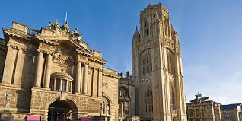
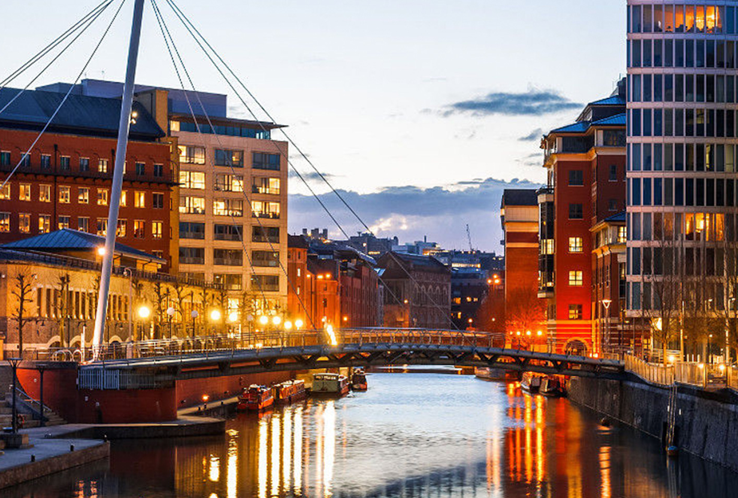
An Analysis on Bristol City for incoming international students from India
Done by: Mohamed Nazim Mohamed Nisar

Slide 2
Introduction
Background
I am from India and I have a masters program admit for September 2020 intake from the University of Bristol. This encouraged me to take up this project so as to educate myself as well as help those Indian students who are either searching for a college or will be travelling soon to Bristol just like me. One of the reasons for choosing Bristol was because of its multicultural society.
Few words about Bristol:
Bristol is a city and county in South West England with a population of 463,400. One of the UK's most popular tourist destinations.
Bristol was selected in 2009 as one of the world's top ten cities by international travel publishers Dorling Kindersley in their Eyewitness series of travel guides.
The Sunday Times named it as the best city in Britain in which to live in 2014 and 2017.
Bristol also won the EU's European Green Capital Award in 2015. (Ref:http://en.wikipedia.org/wiki/Bristol)

Slide 3
Bristol welcomes students from more than 150 countries across the world. To put things in perspective, more than 30,000 Indian students fly to the UK for higher education purposes. As of now, thousands of Indian students enter Bristol every year to pursue the highly valued education and become part of a vibrant community.
PROJECT IDEA:
The idea for this capstone project is to analyze Bristol from the perspective of an Indian student and help them get familiar with neighborhoods, venues, tourist spots and other key insights. The idea is now broken down into achievable Project Objectives.

Slide 4
PROJECT OBJECTIVES:
To identify parts of Bristol that have the most number of Indians.
To find out the neighborhoods which are highly likely to offer the most to an Indian student.
To explore neighborhoods and understand the most frequently found venue categories.
To understand about the university neighborhoods in Bristol and which one offers the more familiar environment for an Indian student.
To discover the top tourist spots in Bristol for the Indian students to visit on their weekends.

Slide 5
TARGET AUDIENCE:
The target audience is the Indian cohort that is either flying to Bristol for higher education or is searching for a suitable destination to pursue their university studies.
This project will certainly help the Indian students who will be travelling to Bristol to pursue higher education choose the right neighborhoods to visit, stay and enjoy the plethora of venues.
It will also help them to better understand the university neighborhoods, especially the necessary venues in the surrounding, and also the famous tourist spots.

Slide 6
2. DATA SECTION
There are quite a few datasets needed to be used in this project.
First, Bristol is divided into wards. The geometric boundaries for these wards are found in the official government website: https://opendata.bristol.gov.uk/explore/dataset/wards/export/. This geojson file helps to get started.This data is used to create exploratory maps of Bristol including choropleth maps in further sections. The geojson file is essential to clearly mark the boundaries of the wards of Bristol in the folium maps.
Second, the population data is found in the same website and under ethnicity: https://opendata.bristol.gov.uk/explore/dataset/ethnicity/. This helps with the first project objective. The Indian population for each ward is found with data from this source. This is done by first creating a pandas dataframe with the names of wards and Indian population for each ward. This can then be used in choropleth maps.

Slide 7
Third, the wards are subdivided into Neighborhoods. The data for this is available at: https://en.wikipedia.org/wiki/Subdivisions_of_Bristol. The web scraping technique, Beautiful Soup, is used to get the necessary data. The location data such as latitude and longitude is compiled using Nominatim. A pandas dataframe is created using the name of the neighborhoods scraped from this website and the collected location data.
Fourth, the Foursquare API becomes essential to identify the different venues in all the neighborhoods, thereby identifying the most suitable/familiar neighborhoods to Indian students and also identify the university with a better Indian-suited neighborhood. The Foursquare API is used to request venues for all the neighborhoods we found using the earlier steps. These venues are then used to analyze how suited they are to an Indian student. This accounts for the Project objectives 2,3 and 4.

Slide 8
Finally, Beautiful Soup is used to scrape data for the top 10 tourist attractions in Bristol from this website: https://www.planetware.com/tourist-attractions-/bristol-eng-av-bristol.htm. The location data is compiled using Nominatim. A data frame consisting of all these data is compiled and used to produce folium maps with markers pointing to the location of the tourist spots. This data is used to achieve the final objective of the project, which is to map the top 10 tourist spots in Bristol.

Slide 9
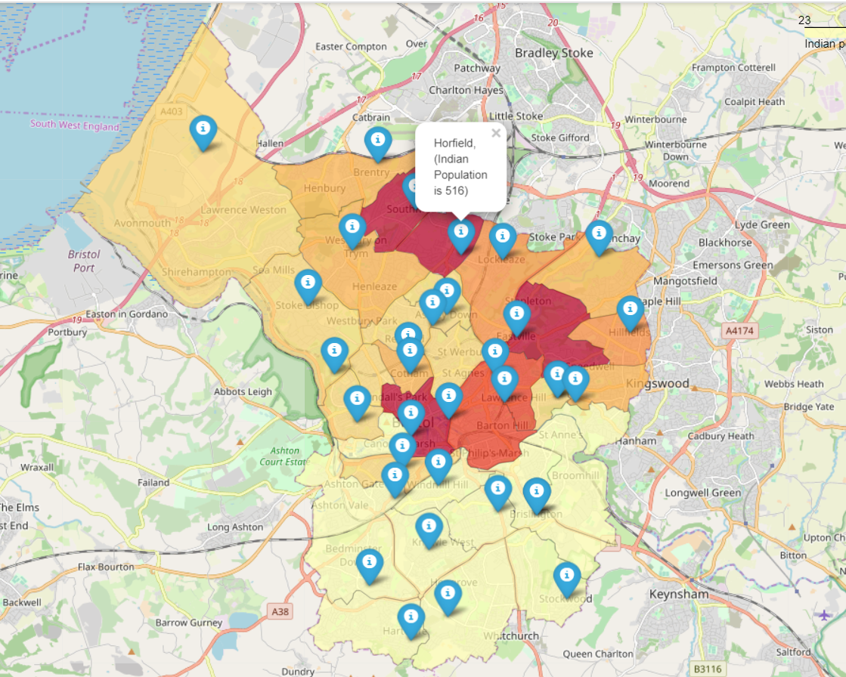
3. METHODOLOGY
3.1. Indian population by wards in Bristol
The choropleth library in folium maps is utilized to visualize ethnicity data of wards in Bristol. This helps to determine those with the highest Indian population.

Slide 10
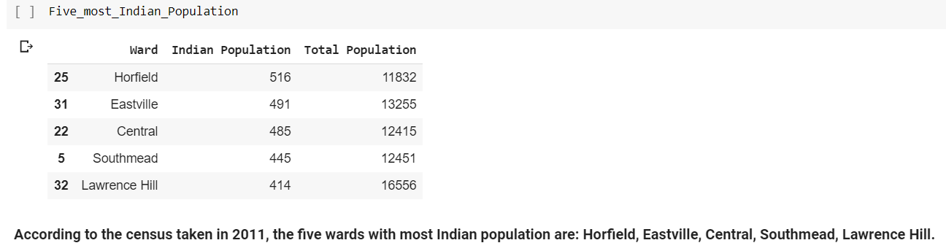
The exploratory analysis is confirmed manually by sorting our pandas dataframe.

Slide 11
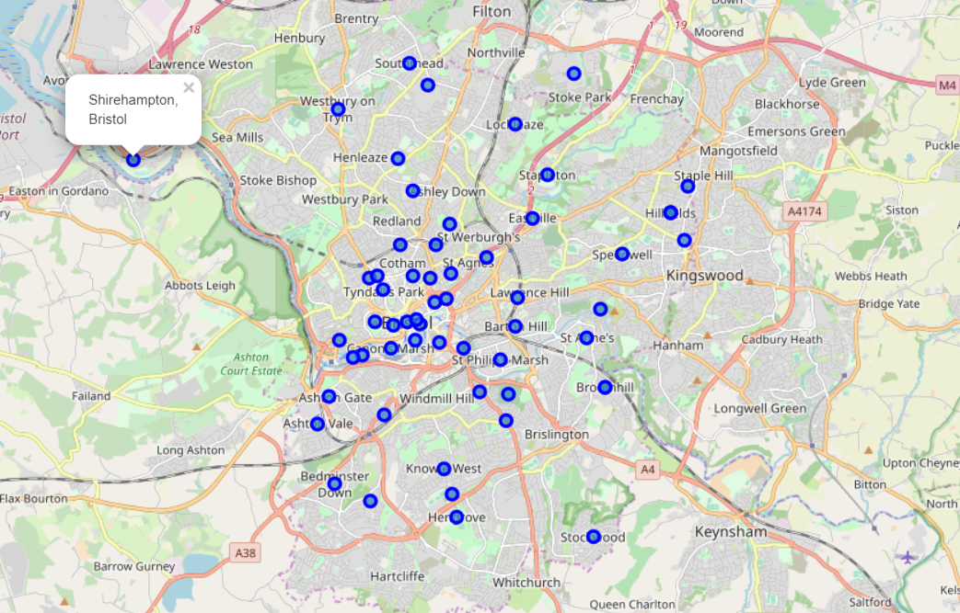
3.2 Exploring Neighborhoods of Bristol
First, the neighborhoods are scraped from a wikipedia page using the technique - Beautiful Soup. These neighborhoods are plotted in folium maps.

Slide 12
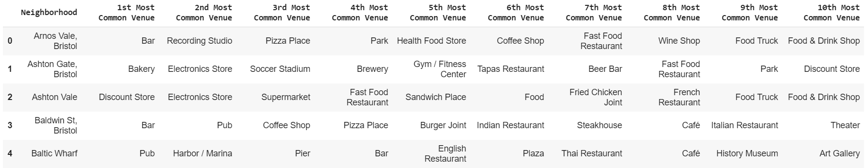
Foursquare is used to get the top 50 venues within a radius of 500 meters for each of the Bristol neighborhoods. One-hot encoding is performed to get the frequency of each venue category. The data is then processed to get the 10 most frequent types of venues in each Bristol neighborhood. Here is a snippet of the output:
The stakeholder is now able to clearly understand the different types of venues present in all the Bristol neighborhoods. The data exploration done in this section is the centerpiece of the project. The reason for this statement will be known in the subsequent sections.

Slide 13
3.3 Criteria List: Neighborhood Familiarity
After getting the top 50 venues using Foursquare and applying one-hot encoding to get the frequency for each of them, a criteria-list is created. This is just a list of venue categories that are familiar to an average Indian. For example, venues under categories such as 'Indian restaurant' and 'Theatre' are much more familiar to an Indian than those under categories like 'Moroccan restaurant' and 'Sushi bar'.
The methodology to rank neighborhoods based on the frequency of the venues is straightforward. A mean of all the venue category frequencies is taken for all the neighborhoods which are then sorted and ranked based on this mean value. Besides, the sum, standard deviation, and the number of unique venue categories are also calculated for better comprehension. It can be seen that 'Monks Park', 'Filwood Park' and 'Arnos Vale' have comparatively higher average frequencies and the number of unique venue categories than the other neighborhoods.
This means that it is more probable for an Indian to encounter several unique venues that are familiar to him at one of these neighborhoods.

Slide 14
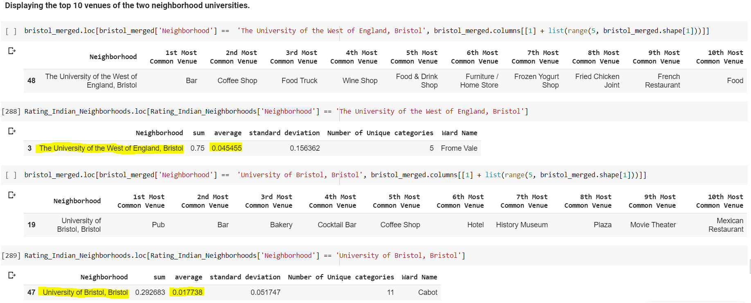
3.3 Exploring University Neighborhoods
After listing the top 10 most common venues of all neighborhoods, the focus is turned towards understanding the university neighborhoods. There are two universities in Bristol namely, ‘The University of the West of England, Bristol’ and ‘The University of Bristol’.
Next, the average venue frequencies of the two university neighborhoods are compared to identify which university provides a more familiar environment to an Indian student.

Slide 15
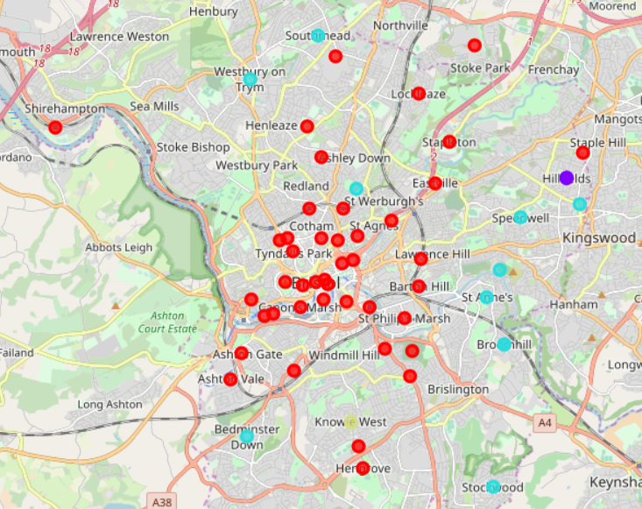
3.4 Clustering
An unsupervised machine learning technique - Clustering, is done in this project. Specifically, the K-means clustering is done. This is to identify similar neighborhoods and cluster them together.
The initial number of K-means clusters is assumed to be 4. The algorithm is run and a folium map is plotted.
It is found that the majority of the neighborhoods are similar, particularly in the central region. There are a handful of neighborhoods in the eastern region that are quite similar. Also, there are clusters with just one to three neighborhoods, meaning that they are very distinct.

Slide 16
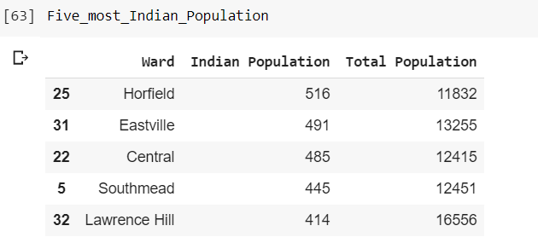
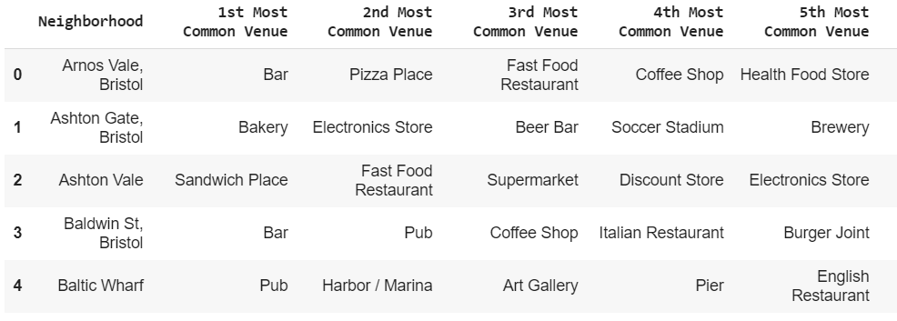
4. Results
Reporting results for each of the project objectives:
To find out the parts of Bristol that have the most number of Indians.
Horfield has the highest number of Indians in Bristol.
To explore neighborhoods and understand the most frequently found venue categories.
The most common venues for all the Bristol neighborhoods are found. The following is a sample snippet of the result.

Slide 17
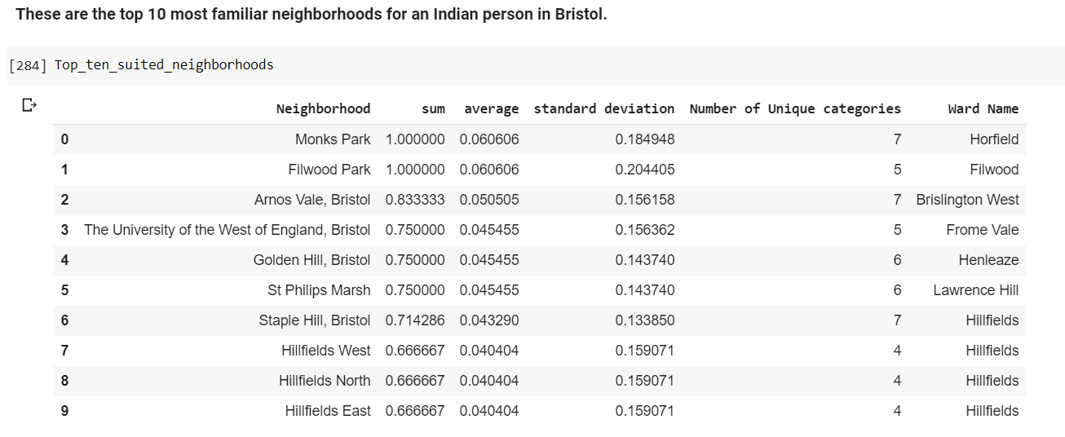
To find out the neighborhoods which are likely to be the most familiar to an Indian student.
These are the ten most familiar Bristol neighborhoods to an Indian.
It can be seen that Monks Park and Filwood Park have the highest average venue frequencies with a good unique number of venues.

Slide 18
To understand about the university neighborhoods in Bristol and which one offers the more familiar environment for an Indian student.
The analysis shows that 'the University of the West of England (UWE)' has more number of familiar venues to Indian students on an average while 'the University of Bristol' has more number of unique familiar venue categories.

Slide 19
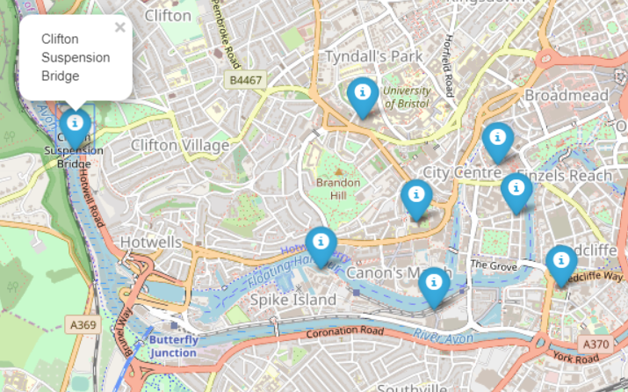
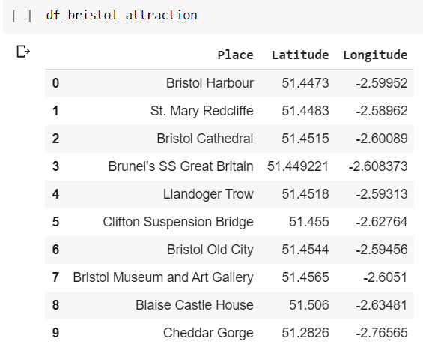
To discover the top tourist spots in Bristol for the Indian students to visit on their weekends.
It is found that 8 out of 10 top Bristol tourist attractions are quite close to the City Centre. The data collected is visualized using the Folium maps.

Slide 20
5. Discussion
There are a few notable patterns and connections in this project. These elements are discussed in this section.
The neighborhood which has the most familiar ambience is ‘Monks Park’ and it is located in the ward of ‘Horfield’. This is also the ward with the most number of Indians. So this result isn’t surprising and is an important point to be noted.
The University of the West of England is a neighborhood with more number of venues that are familiar to an Indian student compared to the University of Bristol.
On the other hand, the University of Bristol has much more unique venue categories that are familiar to an Indian student. That is, UWE might have 4 Indian restaurants but UofB might have 2 Indian restaurants and 1 theatre. So, both the university neighborhoods have something to offer to the Indian students.
Around 8 out of 10 top attractions at Bristol are very close to the University of Bristol whereas the University of the West of England is located on the northern end of the county and so commuting may be more difficult.
The clustering suggests that the University neighborhoods are very different. This is probably because of their distant locations.

Slide 21
6. Conclusion
The following can be concluded from this project:
If you are an Indian student looking for a University that suits you, you may choose either of the universities as they both have something to offer.
Provided you are okay with the programs offered by either of the universities, choose UWE if you would look to stay away from the hassles of a tourist place and be in a familiar environment with many options to choose from within the same venue category.
On the other hand, choose University of Bristol if you would like to live in a vibrant community and also be in close proximity to a diverse range of familiar venues without many options.
You can also visit Horfield to become part of the largest Indian community in Bristol. This ward is also home to the Monks park which is a neighborhood that could be very much familiar to you.

